Slide 1
My journal to python ver.1
11/23
NAME: 艾綺絲
STUDENT ID: 4110E224

Slide 2
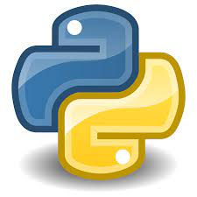

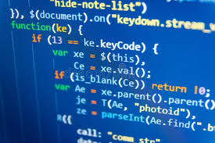
Agenda:
PYTHON (INTRODUCTON)
PYTHON COMMENTS
PYTHON VARIABLES
PYTHON NUMBERS
PYTHON CASTING
PYTHON STRINGS
PYTHON BOOLEANS
PYTHON OPERATORS

Slide 3

PYTHON : PYTHON INTRODUCTION
What is Python?
Python is a popular programming language. It was created by Guido van Rossum, and released in 1991.
It is used for:
web development (server-side),
software development,
mathematics,
system scripting.
EXAMPLE:
# This program prints Hello, everyone!
print('Hello, everyone!)

Slide 4
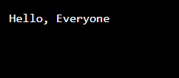
EXAMPLE:
# This program prints Hello, everyone!
print('Hello, everyone!)

Slide 5

PYTHON: IT IS USE FOR:
Web development (server-side)
Server-side scripting is a technique used in web development which involves employing scripts on a web server which produces a response customized for each user's request to the website. The alternative is for the web server itself to deliver a static web page.

Slide 6

Software development
Python is often used as a support language for software developers, for build control and management, testing, and in many other ways.

Slide 7
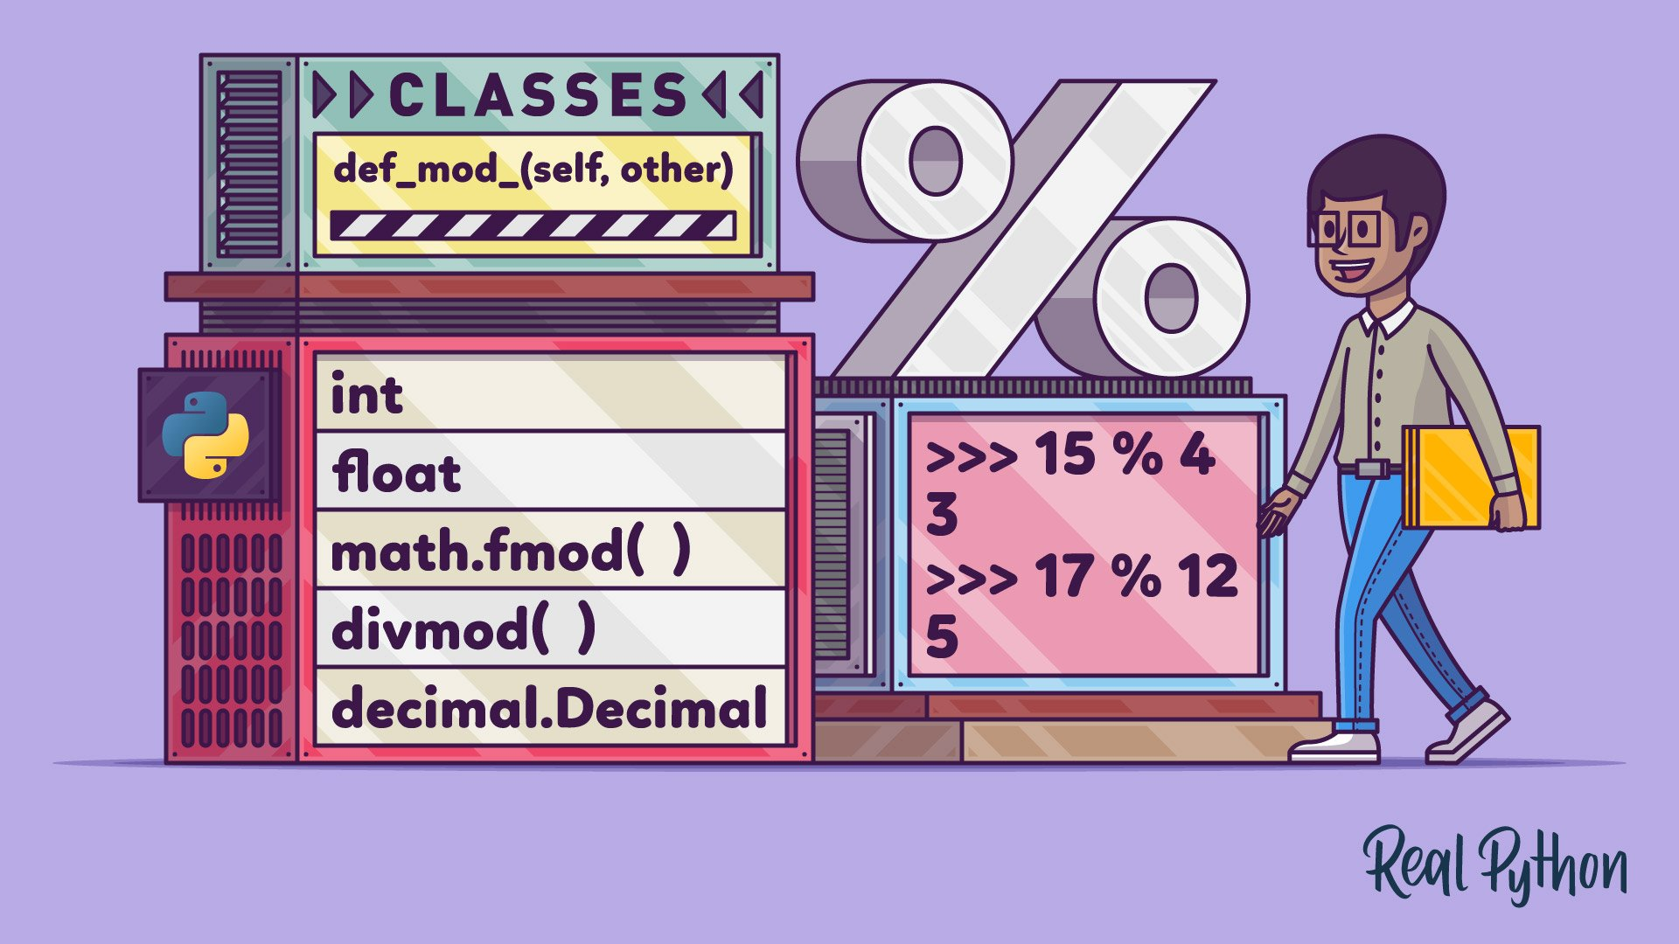
Mathematics
Python has a set of built-in math functions, including an extensive math module, that allows you to perform mathematical tasks on numbers.

Slide 8
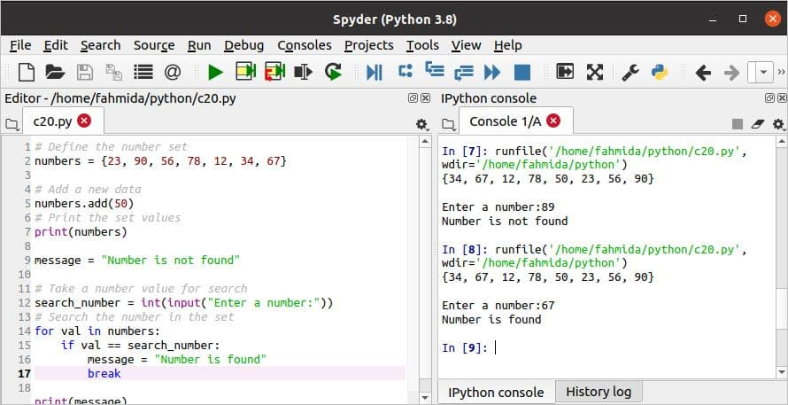
System scripting
Scripting is a very common practice among Python programmers. It's used for automation of daily tasks, reporting, server management, security, social media management, business growth and development, financial trading, automating software and many other intelligent solutions.

Slide 9


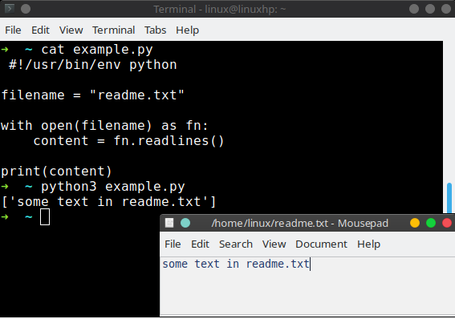
What can Python do?
Python can be used on a server to create web applications.
Python can be used alongside software to create workflows.
Python can connect to database systems. It can also read and modify files.

Slide 10

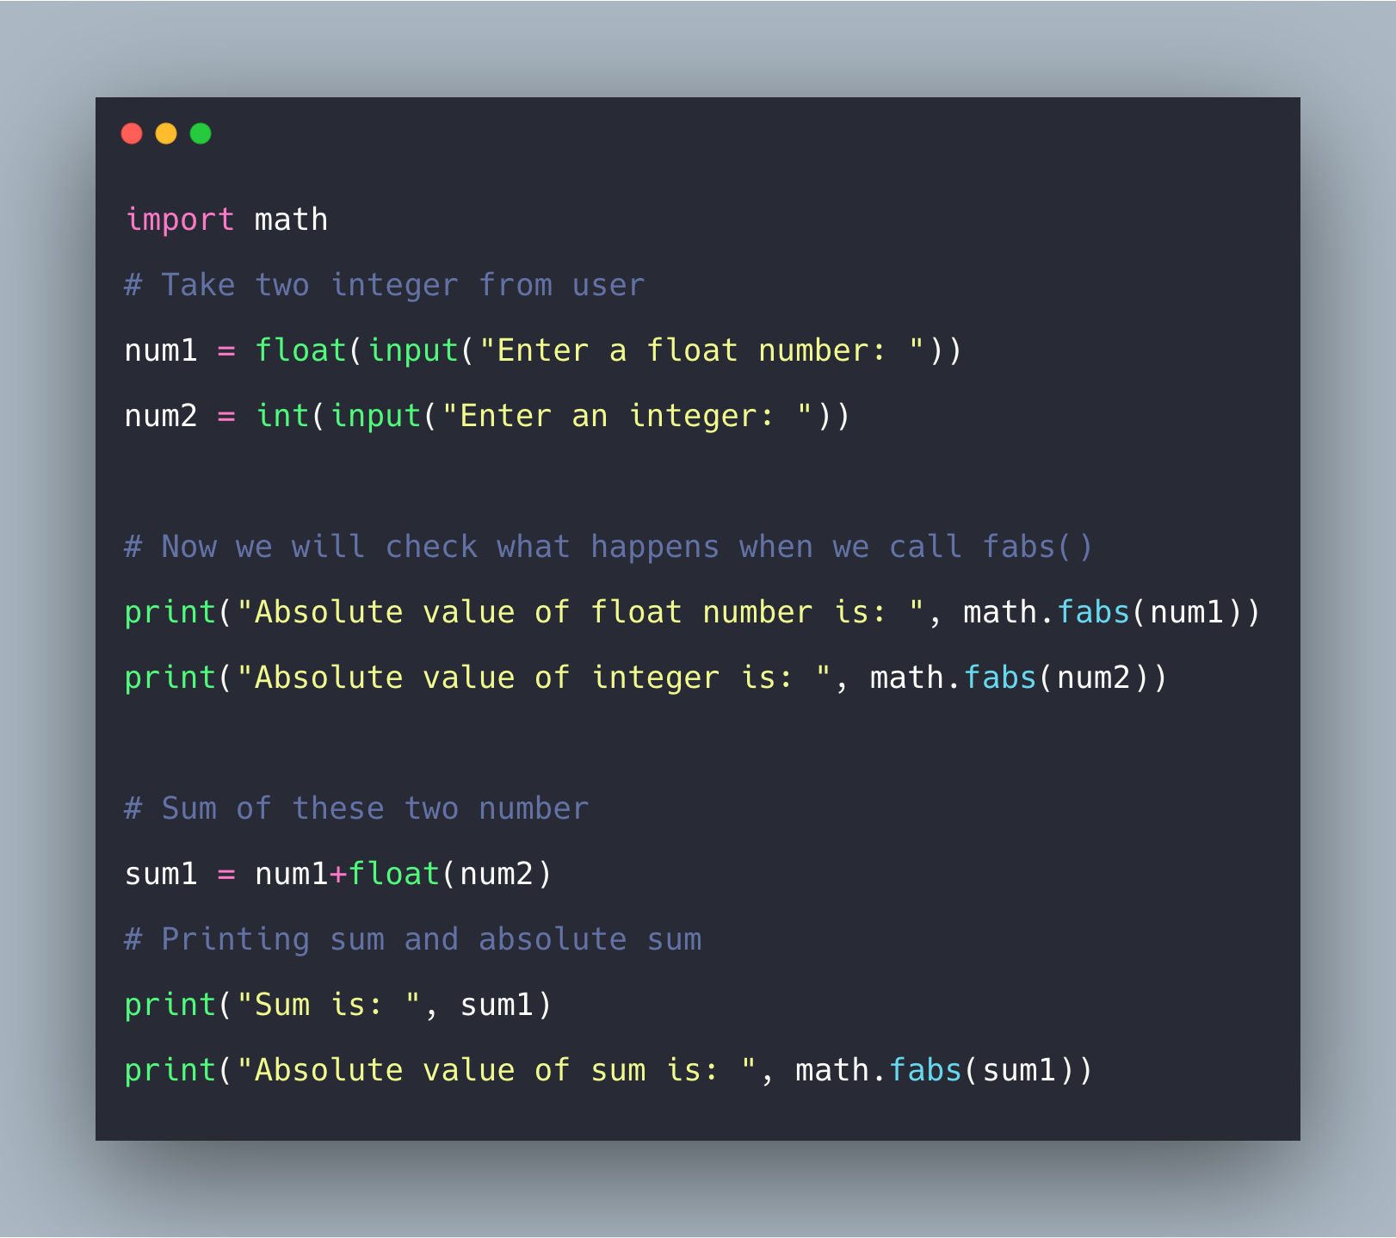

Python can be used to handle big data and perform complex mathematics.
Python can be used for rapid prototyping, or for production-ready software development.

Slide 11

PYTHON COMMENTS
Hash symbol
Comments in Python are identified with a hash symbol, #, and extend to the end of the line.
Comments can be used to explain Python code.
Comments can be used to make the code more readable.
Comments can be used to prevent execution when testing code
EXAMPLE:
#This is a comment print("Hello, Everyone!“)

Slide 12

Comments can be placed at the end of a line, and Python will ignore the rest of the line:
Example
print("Hello, World!") #This is a comment

Slide 13

A comment does not have to be text that explains the code, it can also be used to prevent Python from executing code:
Example
#print("Hello, World!")
print("Nice, One!")

Slide 14
Multi Line Comments
Example
#This is a comment
#written in
#more than just one line
print("Hello, Everyone!")
Python does not really have a syntax for multi line comments.
To add a multiline comment you could insert a # for each line:

Slide 15
Or, not quite as intended, you can use a multiline string.
Since Python will ignore string literals that are not assigned to a variable, you can add a multiline string (triple quotes) in your code, and place your comment inside it:
Example
"""
This is a comment
written in
more than just one line
"""
print("Hello, World!")
As long as the string is not assigned to a variable, Python will read the code, but then ignore it, and you have made a multiline comment.

Slide 16


Python variables
Variables
Variables are containers for storing data values.
Creating Variables
Python has no command for declaring a variable.
A variable is created the moment you first assign a value to it.

Slide 17


Variables do not need to be declared with any particular type, and can even change type after they have been set.

Slide 18
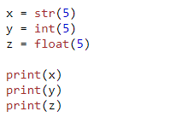

Casting
If you want to specify the data type of a variable, this can be done with casting.

Slide 19
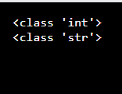
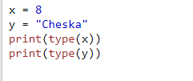
Get the Type
You can get the data type of a variable with the type() function.

Slide 20
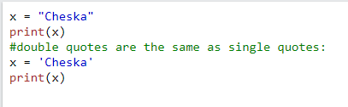

Single or Double Quotes?
String variables can be declared either by using single or double quotes:

Slide 21
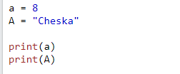
Case-Sensitive
Variable names are case-sensitive.
Example
This will create two variables:

Slide 22
Python –variable names
A variable can have a short name (like x and y) or a more descriptive name (age, carname, total_volume). Rules for Python variables:
A variable name must start with a letter or the underscore character
A variable name cannot start with a number
A variable name can only contain alpha-numeric characters and underscores (A-z, 0-9, and _ )
Variable names are case-sensitive (age, Age and AGE are three different variables)

Slide 23
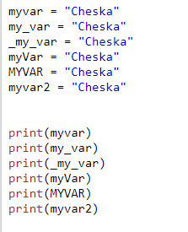
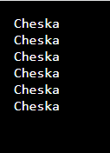
Example
Legal variable names:

Slide 24
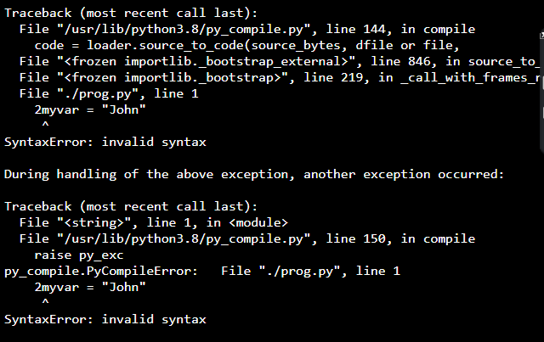
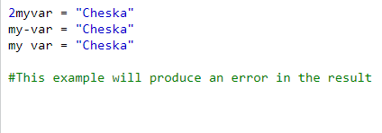
Example
Illegal variable names:

Slide 25
Multi Words Variable Names
Variable names with more than one word can be difficult to read.
There are several techniques you can use to make them more readable:

Slide 26
Camel Case
Each word, except the first, starts with a capital letter:
myVariableName = "Cheska"
Pascal Case
Each word starts with a capital letter:
MyVariableName = "Cheska"
Snake Case
Each word is separated by an underscore character:
my_variable_name = "Cheska"

Slide 27

Python Variables - Assign Multiple Values
different variable names
Example:
x, y, z = “Apple", "Strawberry", "Mango" print(x) print(y) print(z)
Python assigns values from right to left. When assigning multiple variables in a single line, different variable names are provided to the left of the assignment operator separated by a comma. The same goes for their respective values except they should be to the right of the assignment operator.
Note: Make sure the number of variables matches the number of values, or else you will get an error.

Slide 28
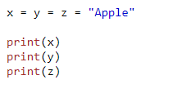
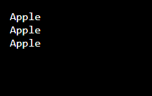
One Value to Multiple Variables
And you can assign the same value to multiple variables in one line:

Slide 29

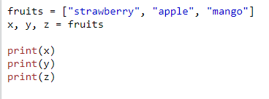
Unpack a Collection
If you have a collection of values in a list, tuple etc. Python allows you to extract the values into variables. This is called unpacking.

Slide 30

Python - Output Variables
example:
x = "Flower is beautiful"
print(x)
The Python print() function is often used to output variables.
print() function

Slide 31
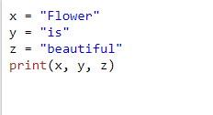

example
In the print() function, you output multiple variables, separated by a comma:

Slide 32
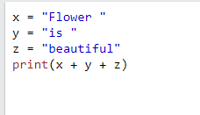
example
You can also use the + operator to output multiple variables:

Slide 33
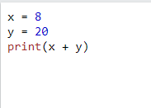

Notice the space character after "Python " and "is ", without them the result would be "Pythonisawesome".
For numbers, the + character works as a mathematical operator:

Slide 34
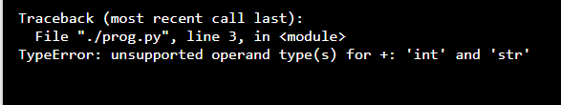

In the print() function, when you try to combine a string and a number with the + operator, Python will give you an error:

Slide 35


The best way to output multiple variables in the print() function is to separate them with commas, which even support different data types:

Slide 36
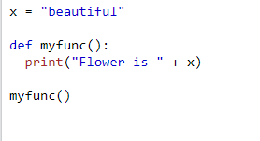

Python - Global Variables
Global Variables
Variables that are created outside of a function are known as global variables.
Global variables can be used by everyone, both inside of functions and outside.

Slide 37
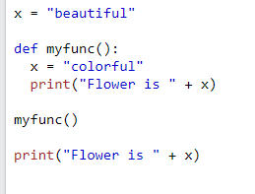

If you create a variable with the same name inside a function, this variable will be local, and can only be used inside the function. The global variable with the same name will remain as it was, global and with the original value.
Example
Create a variable inside a function, with the same name as the global variable

Slide 38
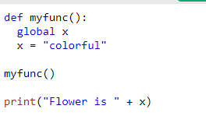

The global Keyword
Normally, when you create a variable inside a function, that variable is local, and can only be used inside that function.
To create a global variable inside a function, you can use the global keyword.
Example
If you use the global keyword, the variable belongs to the global scope:

Slide 39
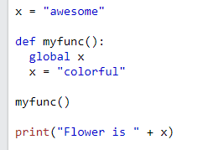
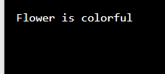
Also, use the global keyword if you want to change a global variable inside a function.
Example
To change the value of a global variable inside a function, refer to the variable by using the global keyword:

Slide 40
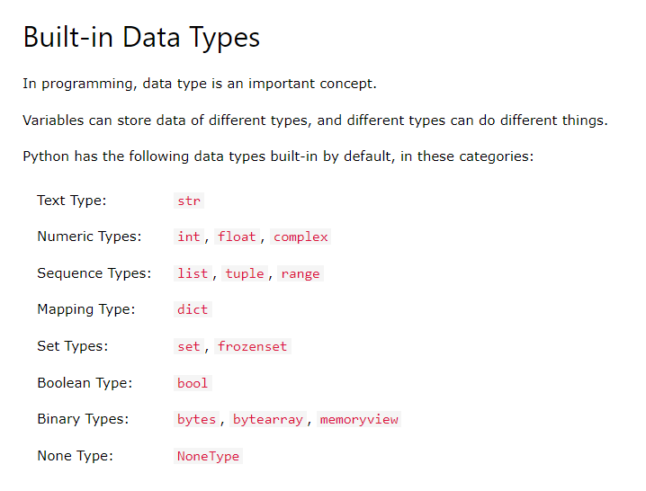
Python Data Types

Slide 41
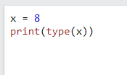

Getting the Data Type
You can get the data type of any object by using the type() function:
Example
Print the data type of the variable x:

Slide 42
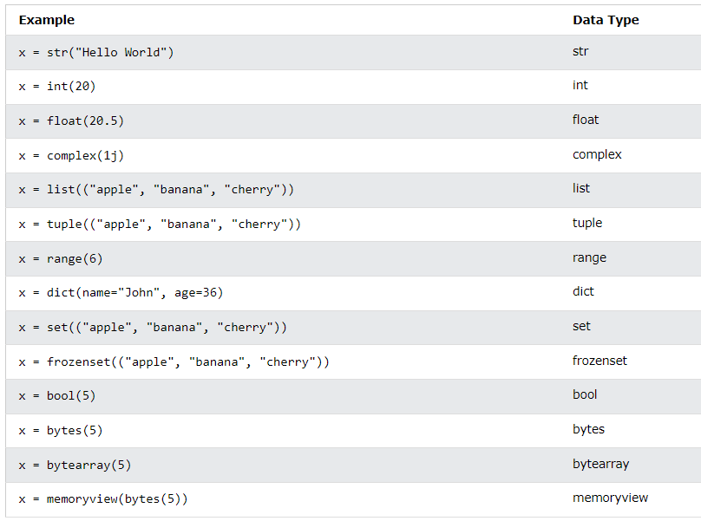
Setting the Specific Data Type
If you want to specify the data type, you can use the following constructor functions:

Slide 43
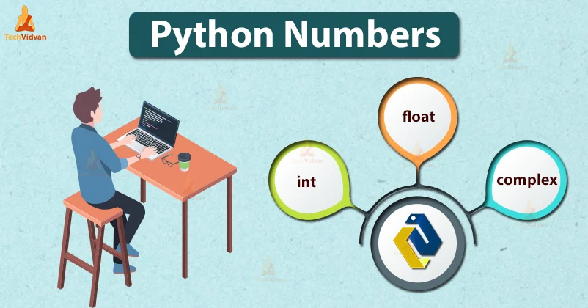
Python numbers
Python supports integers, floating-point numbers and complex numbers. They are defined as int , float , and complex classes in Python. Integers and floating points are separated by the presence or absence of a decimal point. For instance, 5 is an integer whereas 5.0 is a floating-point number.

Slide 44
python: three numeric types
Integer - Int, or integer, is a whole number, positive or negative, without decimals, of unlimited length.
Float - Float, or "floating point number" is a number, positive or negative, containing one or more decimals.
Complex - Complex numbers are written with a "j" as the imaginary part

Slide 45

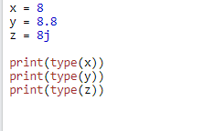
example

Slide 46
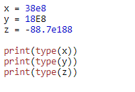
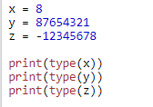
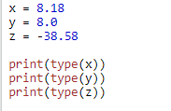



example
Integers
Floats
Complex

Slide 47
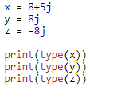

complex
Complex numbers are written with a "j" as the imaginary part:
Example
Complex:

Slide 48
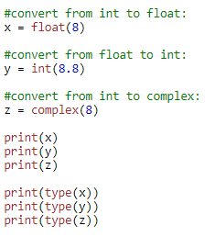
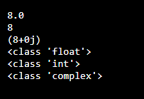
Type Conversion
You can convert from one type to another with the int(), float(), and complex() methods
Example
Convert from one type to another:
Note: You cannot convert complex numbers into another number type.

Slide 49


Random Number
Python does not have a random() function to make a random number, but Python has a built-in module called random that can be used to make random numbers
Example
Import the random module, and display a random number between 1 and 9:

Slide 50
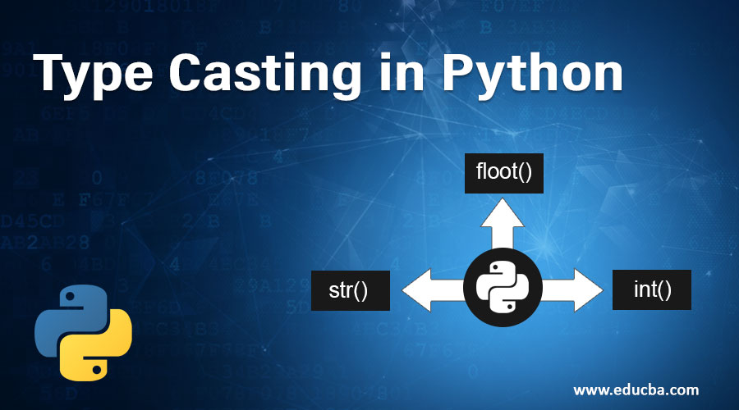
Python Casting
Casting, also known as type conversion, is a process that converts the data type of a variable into another data type.

Slide 51
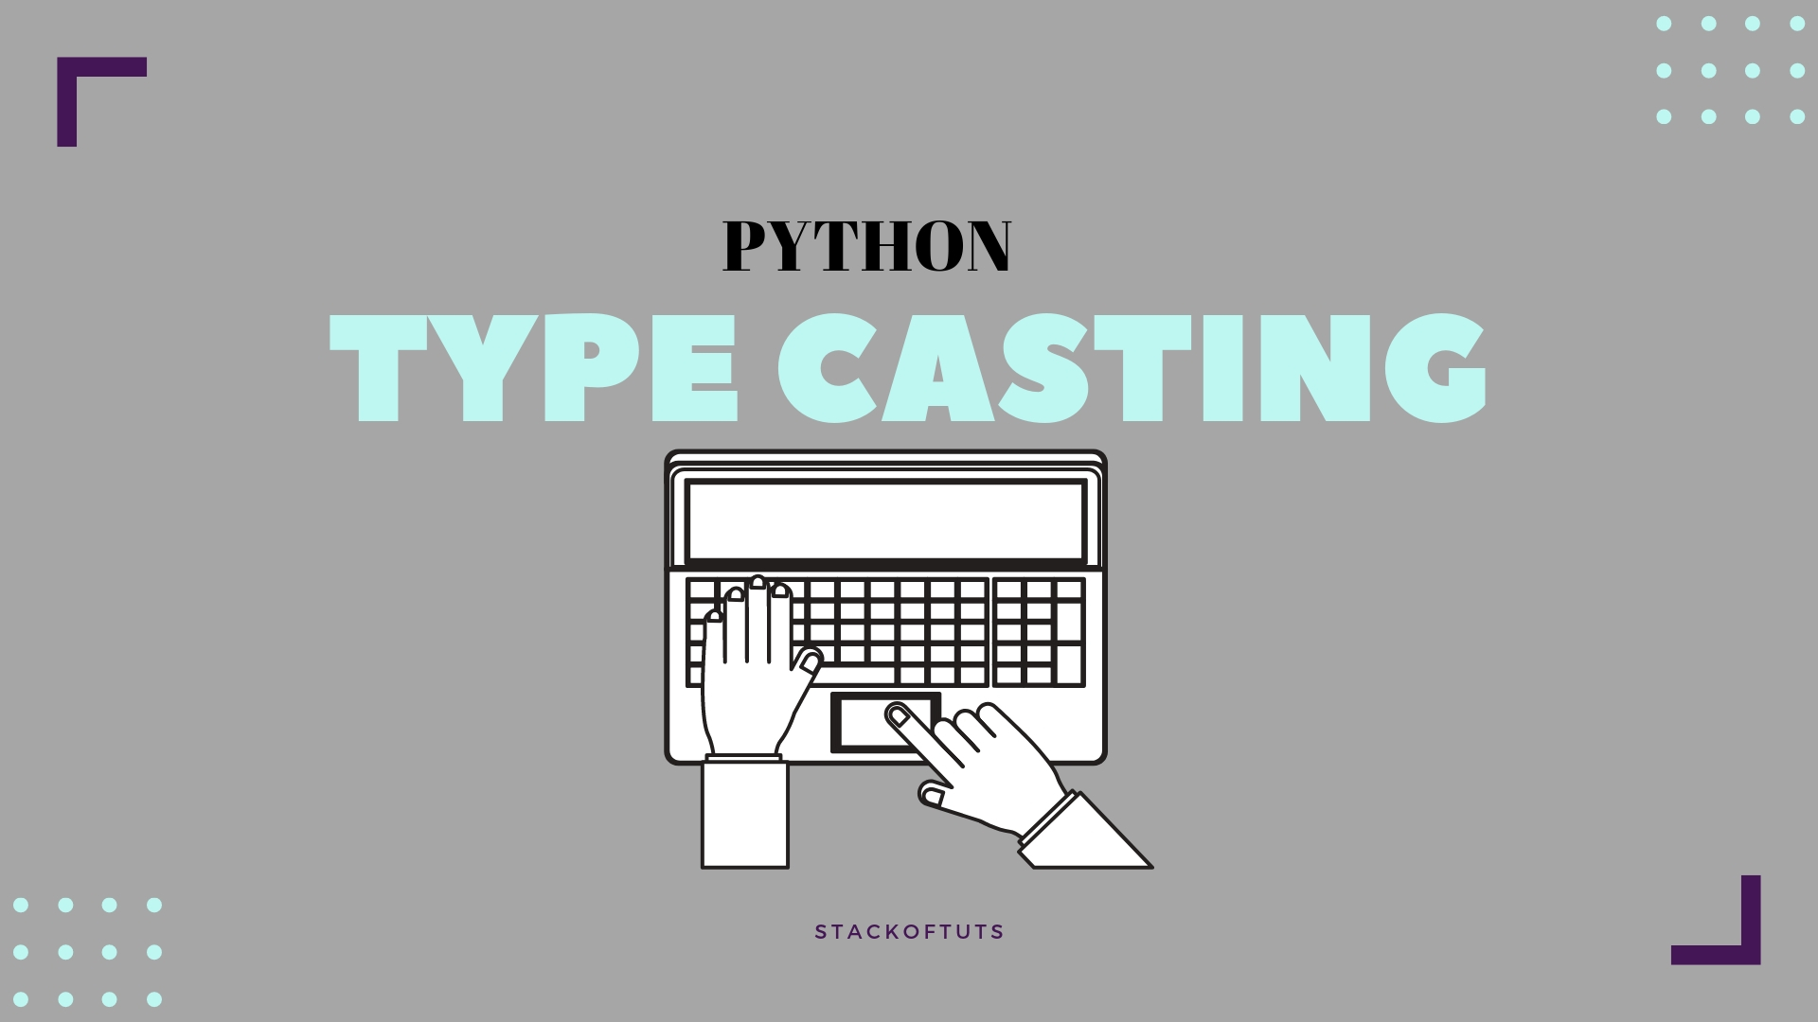
Specify a Variable Type
There may be times when you want to specify a type on to a variable. This can be done with casting. Python is an object-orientated language, and as such it uses classes to define data types, including its primitive types.

Slide 52
Casting in python is therefore done using constructor functions:
int() - constructs an integer number from an integer literal, a float literal (by removing all decimals), or a string literal (providing the string represents a whole number)
float() - constructs a float number from an integer literal, a float literal or a string literal (providing the string represents a float or an integer)
str() - constructs a string from a wide variety of data types, including strings, integer literals and float literals

Slide 53
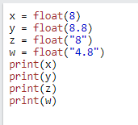





example
Integers
Float
String
3

Slide 54


Python Strings
Strings
Strings in python are surrounded by either single quotation marks, or double quotation marks.
'hello' is the same as "hello".
You can display a string literal with the print() function:

Slide 55


Assign String to a Variable
Assigning a string to a variable is done with the variable name followed by an equal sign and the string:

Slide 56


Multiline Strings
You can assign a multiline string to a variable by using three quotes:
Example
You can use three double quotes:

Slide 57
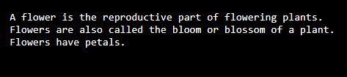
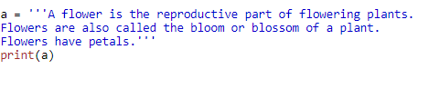
Or three single quotes:
Example
Note: in the result, the line breaks are inserted at the same position as in the code.

Slide 58


Strings are Arrays
Like many other popular programming languages, strings in Python are arrays of bytes representing unicode characters.
However, Python does not have a character data type, a single character is simply a string with a length of 1.
Square brackets can be used to access elements of the string.
Example
Get the character at position 1 (remember that the first character has the position 0):

Slide 59
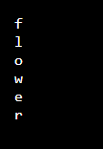

Looping Through a String
Since strings are arrays, we can loop through the characters in a string, with a for loop.
Example
Loop through the letters in the word “flower":

Slide 60


String Length
To get the length of a string, use the len() function.
Example
The len() function returns the length of a string:

Slide 61




Check String
To check if a certain phrase or character is present in a string, we can use the keyword in.
Example
Check if “reason" is present in the following text:
Use it in an if statement:
Example
Print only if "free" is present:

Slide 62


Check if NOT
To check if a certain phrase or character is NOT present in a string, we can use the keyword not in.
Example
Check if “beautiful" is NOT present in the following text:

Slide 63


Use it in an if statement:
Example
print only if “beautiful" is NOT present:

Slide 64


Python - Slicing Strings
Slicing
You can return a range of characters by using the slice syntax.
Specify the start index and the end index, separated by a colon, to return a part of the string.
Example:
Get the characters from position 3 to position 6 (not included)

Slide 65


Slice From the Start
By leaving out the start index, the range will start at the first character:
Example
Get the characters from the start to position 8 (not included):

Slide 66


Slice To the End
By leaving out the end index, the range will go to the end:
Example
Get the characters from position 2, and all the way to the end:

Slide 67


Negative Indexing
Use negative indexes to start the slice from the end of the string:
Example
Get the characters:
From: "o" in “Everyone!" (position -5)
To, but not included: “n" in “Everyone" (position -3):

Slide 68
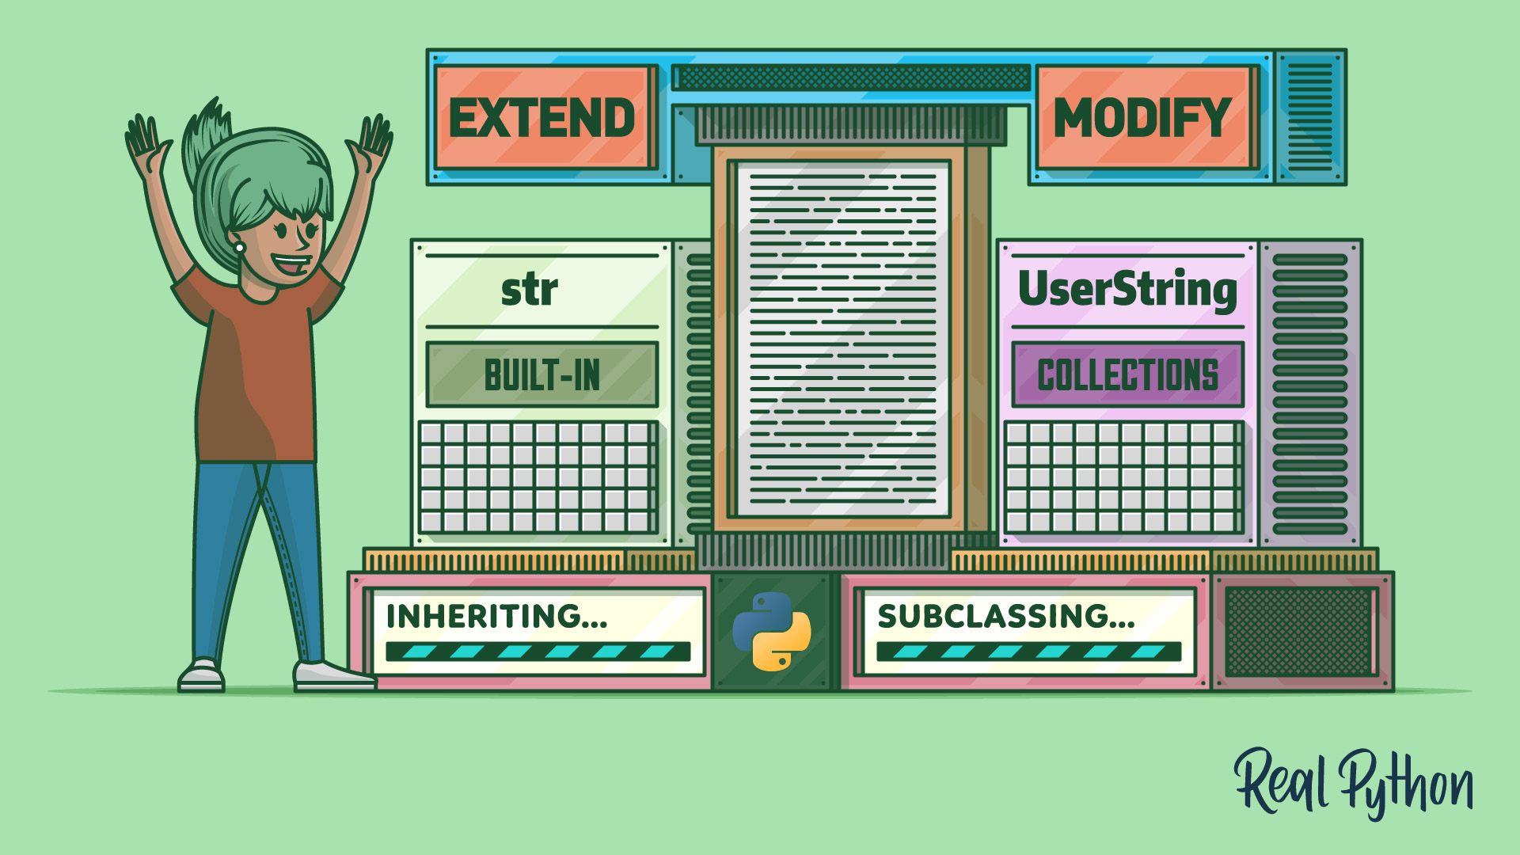
Python - Modify Strings
Python has a set of built-in methods that you can use on strings.

Slide 69



EXAMPLES
Upper case
Lower case
example
The upper() method returns the string in upper case:
example
The lower() method returns the string in lower case:

Slide 70


Remove Whitespace
Whitespace is the space before and/or after the actual text, and very often you want to remove this space
Example
The strip() method removes any whitespace from the beginning or the end:

Slide 71


Replace String
Example
The replace() method replaces a string with another string:

Slide 72


Split String
The split() method returns a list where the text between the specified separator becomes the list items.
Example
The split() method splits the string into substrings if it finds instances of the separator:

Slide 73




Python - String Concatenation
String Concatenation
To concatenate, or combine, two strings you can use the + operator.
Example
Merge variable a with variable b into variable c:
Example
To add a space between them, add a " ":

Slide 74


Python - Format - Strings
String Format
As we learned in the Python Variables chapter, we cannot combine strings and numbers like this
Example

Slide 75


But we can combine strings and numbers by using the format() method!
The format() method takes the passed arguments, formats them, and places them in the string where the placeholders {} are:

Slide 76
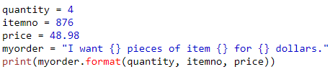
The format() method takes unlimited number of arguments, and are placed into the respective placeholders:

Slide 77
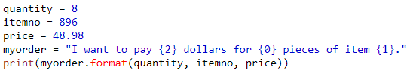
You can use index numbers {0} to be sure the arguments are placed in the correct placeholders:

Slide 78
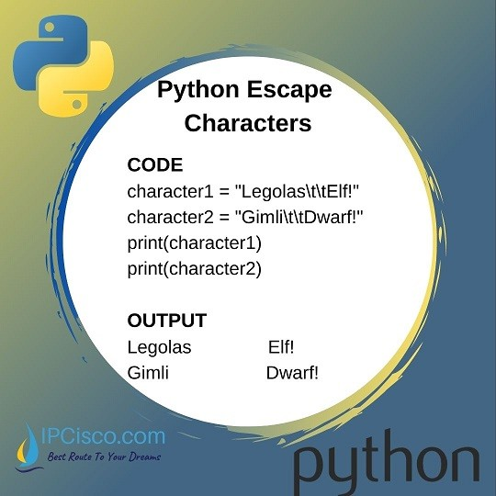
Python - Escape Characters
Escape Character
To insert characters that are illegal in a string, use an escape character.
An escape character is a backslash \ followed by the character you want to insert.

Slide 79

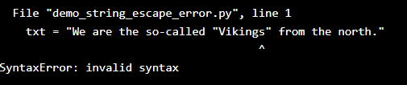
An example of an illegal character is a double quote inside a string that is surrounded by double quotes:

Slide 80

To fix this problem, use the escape character \":

Slide 81
Escape Characters Other escape characters used in Python:
Code | Result
\' \\ \n \r \t \b \f \ooo \xhh
Single Quote Backslash New Line Carriage Return Tab Backspace Form Feed Octal Value Hex Value

Slide 82
Python - String Methods
String Methods
Python has a set of built-in methods that you can use on strings.
Note: All string methods return new values. They do not change the original string.

Slide 83
Method | Description
capitalize() | Converts the first character to upper case
casefold() | Converts string into lower case
center() | Returns a centered string
count() | Returns the number of times a specified value occurs in a string
encode() | Returns an encoded version of the string
endswith() | Returns true if the string ends with the specified value
expandtabs() | Sets the tab size of the string
find() | Searches the string for a specified value and returns the position of where it was found
format() | Formats specified values in a string
format_map() | Formats specified values in a string

Slide 84
index() | Searches the string for a specified value and returns the position of where it was found
isalnum() | Returns True if all characters in the string are alphanumeric
isalpha() | Returns True if all characters in the string are in the alphabet
isdecimal() | Returns True if all characters in the string are decimals
isdigit() | Returns True if all characters in the string are digits
isidentifier() | Returns True if the string is an identifier
islower() | Returns True if all characters in the string are lower case
isnumeric() | Returns True if all characters in the string are numeric
isprintable() | Returns True if all characters in the string are printable
isspace() | Returns True if all characters in the string are whitespaces
istitle() | Returns True if the string follows the rules of a title

Slide 85
isupper() | Returns True if all characters in the string are upper case
join() | Joins the elements of an iterable to the end of the string
ljust() | Returns a left justified version of the string
lower() | Converts a string into lower case
lstrip() | Returns a left trim version of the string
maketrans() | Returns a translation table to be used in translations
partition() | Returns a tuple where the string is parted into three parts
replace() | Returns a string where a specified value is replaced with a specified value
rfind() | Searches the string for a specified value and returns the last position of where it was found
rindex() | Searches the string for a specified value and returns the last position of where it was found
rjust() | Returns a right justified version of the string

Slide 86
rpartition() | Returns a tuple where the string is parted into three parts
rsplit() | Splits the string at the specified separator, and returns a list
rstrip() | Returns a right trim version of the string
split() | Splits the string at the specified separator, and returns a list
splitlines() | Splits the string at line breaks and returns a list
startswith() | Returns true if the string starts with the specified value
strip() | Returns a trimmed version of the string
swapcase() | Swaps cases, lower case becomes upper case and vice versa
title() | Converts the first character of each word to upper case
translate() | Returns a translated string
upper() | Converts a string into upper case
zfill() | Fills the string with a specified number of 0 values at the beginning

Slide 87


Python Booleans
Booleans represent one of two values: True or False.
Boolean Values
In programming you often need to know if an expression is True or False.
You can evaluate any expression in Python, and get one of two answers, True or False.
When you compare two values, the expression is evaluated and Python returns the Boolean answer:

Slide 88


When you run a condition in an if statement, Python returns True or False:
Example
Print a message based on whether the condition is True or False:

Slide 89



Evaluate Values and Variables
The bool() function allows you to evaluate any value, and give you True or False in return,
Example
Evaluate a string and a number:
Example
Evaluate two variables:

Slide 90


Most Values are True
Almost any value is evaluated to True if it has some sort of content.
Any string is True, except empty strings.
Any number is True, except 0.
Any list, tuple, set, and dictionary are True, except empty ones.
Example
The following will return True:

Slide 91


Some Values are False
In fact, there are not many values that evaluate to False, except empty values, such as (), [], {}, "", the number 0, and the value None. And of course the value False evaluates to False.

Slide 92


One more value, or object in this case, evaluates to False, and that is if you have an object that is made from a class with a __len__ function that returns 0 or False:
Example

Slide 93


Functions can Return a Boolean
You can create functions that returns a Boolean Value:
Example
Print the answer of a function:

Slide 94


You can execute code based on the Boolean answer of a function:
Example
Print "YES!" if the function returns True, otherwise print "NO!":

Slide 95


Python also has many built-in functions that return a boolean value, like the isinstance() function, which can be used to determine if an object is of a certain data type:
Example
Check if an object is an integer or not:

Slide 96


Python Operators
Python Operators
Operators are used to perform operations on variables and values.
In the example below, we use the + operator to add together two values:
+ operator
Example
print(18 + 8)

Slide 97
Python divides the operators in the following groups:
Arithmetic operators
Assignment operators
Comparison operators
Logical operators
Identity operators
Membership operators
Bitwise operators

Slide 98
Python Arithmetic Operators
Arithmetic operators are used with numeric values to perform common mathematical operations:
Operator | Name | Example
+ | Addition | x + y
- | Subtraction | x - y
* | Multiplication | x * y
/ | Division | x / y
% | Modulus | x % y
** | Exponentiation | x ** y
// | Floor Division | x // y

Slide 99
Python Assignment Operators
Assignment operators are used to assign values to variables:
Operator | Example | Same As
= | x = 5 | x = x = 5
+= | x += 3 | x = x + 3
-= | x -= 3 | x = x - 3
*= | x *= 3 | x = x * 3
/= | x /= 3 | x = x / 3
%= | x %= 3 | x = x % 3
//= | x //= 3 | x = x // 3
**= | x **= 3 | x = x ** 3
&= | x &= 3 | x = x & 3
|= | x |= 3 | x = x | 3
^= | x ^= 3 | x = x ^ 3
>>= | x >>= 3 | x = x >> 3
<<= | x <<= 3 | x = x << 3

Slide 100
Python Comparison Operators
Comparison operators are used to compare two values:
Operator | Name | Example
== | Equal | x == y
!= | Not equal | x != y
> | Greater than | x > y
< | Less than | x < y
>= | Greater than or equal to | x >= y
<= | Less than or equal to | x <= y

Slide 101
Python Logical Operators
Logical operators are used to combine conditional statements:
Operator | Description | Example
and | Returns True if both statements are true | x < 5 and x < 10
or | Returns True if one of the statements is true | x < 5 or x < 4
not | Reverse the result, returns False if the result is true | not(x < 5 and x < 10)

Slide 102
Python Identity Operators
Identity operators are used to compare the objects, not if they are equal, but if they are actually the same object, with the same memory location:
Operator | Description | Example
is | Returns True if both variables are the same object | x is y
is not | Returns True if both variables are not the same object | x is not y

Slide 103



Python Membership Operators
Membership operators are used to test if a sequence is presented in an object:
Operator | Description | Example
in | Returns True if a sequence with the specified value is present in the object | x in y
not in | Returns True if a sequence with the specified value is present in the object | x not in y
EXAMPLE

Slide 104
Python Bitwise Operators
Bitwise operators are used to compare (binary) numbers:
Operator | Name | Description
& | AND | Sets each bit to 1 if both bits are 1
| | OR | Sets each bit to 1 if one of two bits is 1
^ | XOR | Sets each bit to 1 if only one of two bits is 1
~ | NOT | Inverts all the bits
<< | Zero fill left shift | Shift left by pushing zeros in from the right and let the leftmost bits fall off
>> | Signed right shift | Shift right by pushing copies of the leftmost bit in from the left, and let the rightmost bits fall off

